Slide 1
THE Sorting hat The SCIENCE HACK DAY SFO 2015 team: Ryan Anderson Erik Danford Xiaomin JIANG Jordan Hart Ognjen Todic David Uli Chris Swanson Jak Kaj .. AND WILLIAM

Slide 2
There's nothing hidden in your head
The Sorting Hat can't see,
So try me on and I will tell you
Where you ought to be.

Slide 3
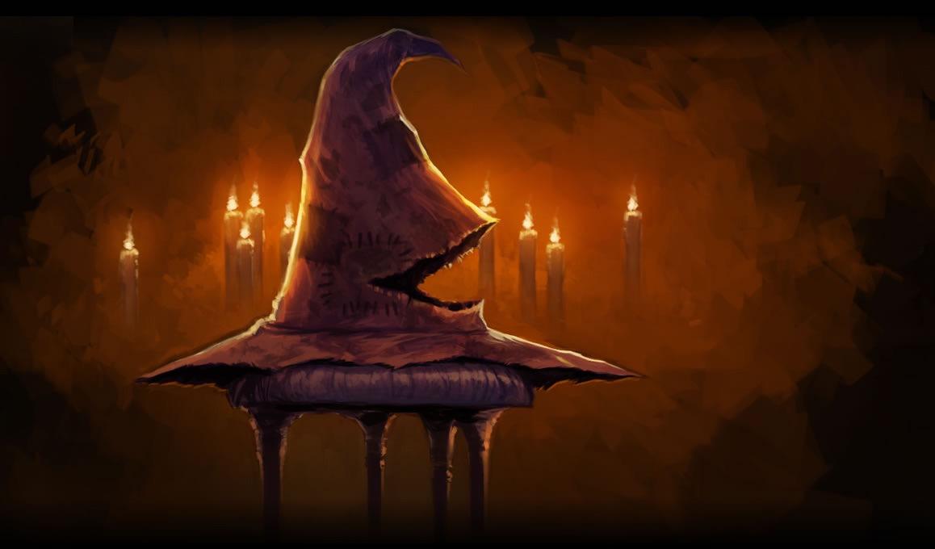
now tell me about yourself…

Slide 4

You are % Gryffindor!
You told the Sorting Hat:
(user input goes here)
The bravest are
Prized far beyond the rest

Slide 5

You are % Hufflepuff!
You told the Sorting Hat:
(user input goes here)
Hard workers are
Most worthy of admission

Slide 6

You are % ravenclaw!
You told the Sorting Hat:
(user input goes here)
The cleverest
Would always be the best

Slide 7

You are % SLYTHERIN!
You told the Sorting Hat:
(user input goes here)
The power-hungry ones
Love those of great ambition

